Slide 1
FWD Project
TOGAF 9 - Core Diagrams
Value Chain Diagrams
Phase A – Architecture Vision

Slide 2
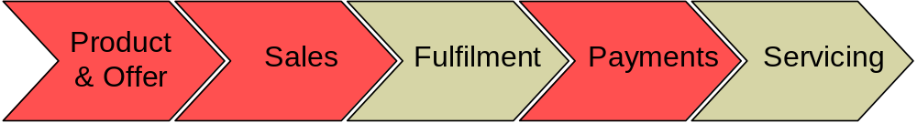
Value Chain Diagram

Slide 3
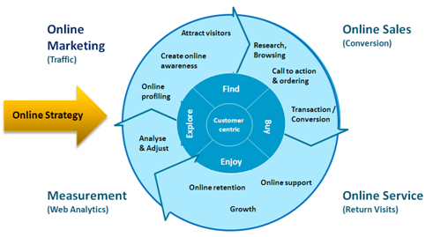
Value Chain Diagram

Slide 4
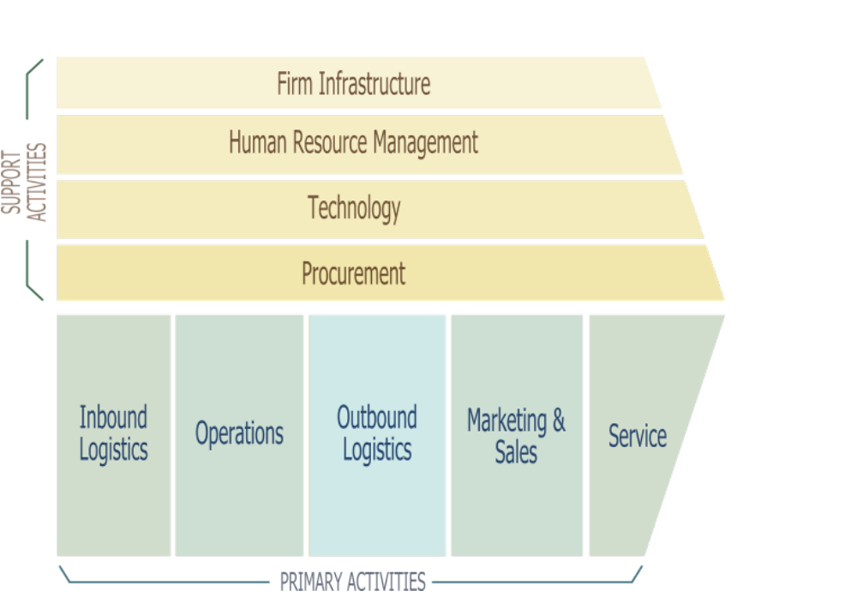
Value Chain Diagram

